Slide 1
Ontology Good and Bad
Barry Smith
Department of Philosophy and NCGIA, Buffalo
http://ontology.buffalo.edu

Slide 2
Ontology as a branch of philosophy
the science of what is
the science of the kinds and structures of objects, properties, events, processes and relations

Slide 3
Ontology seeks to provide a definitive and exhaustive classification of entities in all spheres of being.

Slide 4
It seeks to answer questions like this:
What classes of entities are needed for a complete description and explanation of the goings-on in the universe?

Slide 5
Ontology is in many respects comparable to the theories produced by science
… but it is radically more general than these

Slide 6
It can be regarded as a kind of generalized chemistry or biology
(Aristotle’s ontology grew out of biological classification applied to what we would now call common-sense reality)

Slide 7
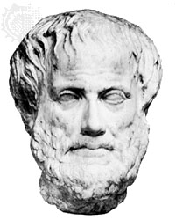
Aristotle
Aristotle
first ontologist

Slide 8
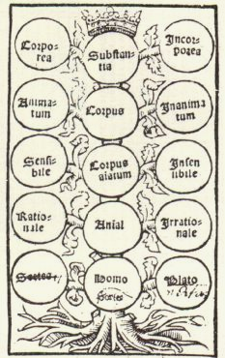
first ontology (from Porphyry‘s Commentary on Aristotle‘s Categories)
Notes:
Porphyry‘s Tree Ca. 1514

Slide 9
Ontology is distinguished from the special sciences in that it seeks to study all of the various types of entities existing at all levels of granularity

Slide 10
and to establish how they hang together to form a single whole (‘reality’ or ‘being’)

Slide 11
Ontology is essentially cross-disciplinary

Slide 12
Methods of ontology:
the development of theories of wider or narrower scope
the testing and refinement of such theories
  by logical formalization (as a kind of experimentation with diagrams)
  by measuring them up against difficult counterexamples and against the results of science and observation

Slide 13
Sources for ontological theorizing:
thought experiments
the study of ancient texts
most importantly: the results of natural science
more recently: controlled experiments on folk ontologies

Slide 14
From Ontology to Ontological Commitment
For Quine, the ontologist studies, not reality,
but scientific theories
… ontology is then the study of the ontological commitments or presuppositions embodied in the different natural sciences

Slide 15
Quine: each natural science has its own preferred repertoire of types of objects to the existence of which it is committed

Slide 16
Quine: only natural sciences can be taken ontologically seriously
The way to do ontology is exclusively through the investigation of scientific theories
All natural sciences are compatible with each other

Slide 17
Growth of Quine-style ontology outside philosophy:
Psychologists and anthropologists (and cognitive geographers) have sought to elicit the ontological commitments (‘ontologies’, in the plural) of different cultures and groups.
They have sought to establish what individual subjects, or entire human cultures, are committed to, ontologically, in their everyday cognition

Slide 18
PROBLEM:
All natural sciences are in large degree consistent with each other
Thus it is reasonable to identify ontology – the search for answers to the question: what exists? – with the study of the ontological commitments of natural scientists

Slide 19
The identification of ontology with the study of ontological commitments still makes sense when one takes into account also certain commonly shared commitments of common sense (for example that fish or cows exist)
But this identification of ontology becomes strikingly less defensible when the ontological commitments of various specialist groups of non-scientists are allowed into the mix.

Slide 20
How, ontologically, are we to treat the commitments of astrologists, or clairvoyants, or believers in leprechauns?

Slide 21
NEW SECTI ON
NEW SECTION

Slide 22
Ontology and Information Science
Some background:
procedural vs. declarative controversy

Slide 23
What is the most suitable form of representation for knowledge/cognition/intelligence?
Proceduralists: the way to create intelligent machines is by instilling as much knowledge of how into a system as possible
Declarativists: artificial intelligence is best arrived at by instilling as much knowledge of what into a system as possible.
Leading early declarativists: Minsky, McCarthy, Pat Hayes, Doug Lenat (CYC)

Slide 24
Both the procedural and the declarative elements of computer systems can be viewed as representations:
Programs are representations of processes (e.g. in a bank),
Data structures are representations of objects (e.g. customers)

Slide 25
The Ontologist’s Credo:
To create effective representations
it is an advantage if one knows something about the objects and processes one is trying to represent.

Slide 26
The Ontologist’s Credo:
To create effective representations
it is an advantage if one knows something about the objects and processes one is trying to represent.

Slide 27
This means
  that one must know something about the specific token objects (employees, taxpayers, domestic partners) recorded in one’s database,
  but also
  something about objects, properties and relations in general, and also about the general types of processes in which objects, properties and relations can be involved.

Slide 28
The growth of ontology
reflects efforts to look beyond the artefacts of computation and information to the big wide world beyond
  It parallels in some respects the growth of object-oriented software,
  where the idea is to organize a program in such a way that its structure mirrors the structure of the objects and relationships in its application domain.

Slide 29
NEW SECTI ON
ANOTHER NEW SECTION

Slide 30
The Tower of Babel Problem
Different groups of system designers have their own idiosyncratic terms and concepts by means of which they represent the information they receive.
The problems standing in the way of putting this information together within a single system increase geometrically.
Methods must be found to resolve terminological and conceptual incompatibilities.

Slide 31
The term ‘ontology’
came to be used by information scientists to describe the construction of a canonical description of this sort.
An ontology is a dictionary of terms formulated in a canonical syntax and with commonly accepted definitions and axioms designed to yield a shared framework for use by different information systems communities.
Above all: to facilitate portability

Slide 32
Ontology =
a concise and unambiguous description of the principal, relevant entities of an application domain and of their potential relations to each other

Slide 33
Enterprise ontology
Ontology used to support enterprise integration:
To make its systems intercommunicable, a large international banking corporation needs a common ontology in order to provide a shared framework of communication
But objects in the realms of finance, credit, securities, collateral are structured and partitioned in different ways in different cultures.

Slide 34
Some successes of ontology
Aristotle
ONTEK (Chuck Dement, Peter Simons)
LADSEB (Nicola Guarino)
GOL (Heinrich Herre, Wolfgang Degen)

Slide 35
ONTEK: Ontology of Aircraft Construction and Maintenance
Ontek’s PACIS system embraces within a single framework
  aircraft parts and functions
  raw-materials and processes involved in manufacturing
  the times these processes and sub-processes take
  job-shop space and equipment
  an array of different types of personnel
  the economic properties of all of these entities

Slide 36
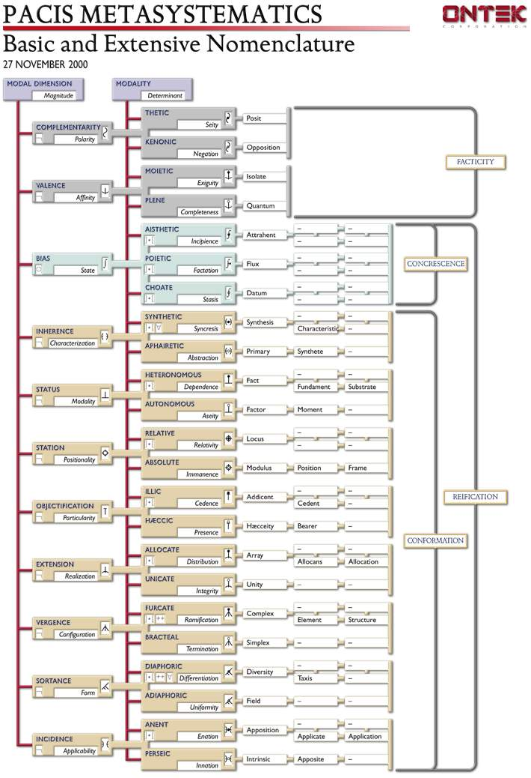
PACIS NOMENCLATURE

Slide 37
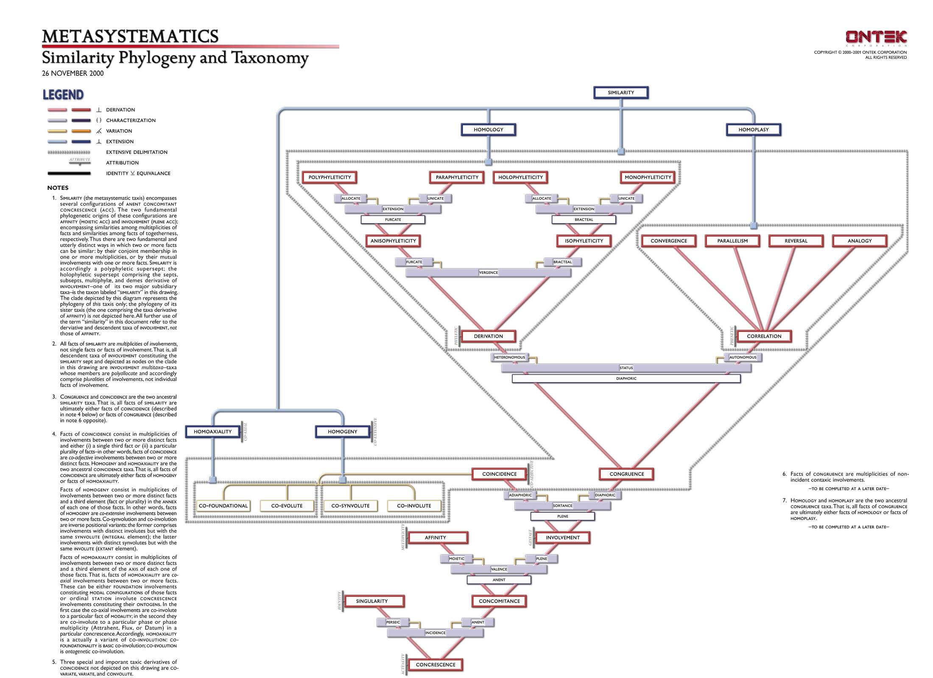
PACIS METASYSTEMATICS (CLADE)

Slide 38
SO FAR
SO GOOD

Slide 40
The Birth of Bad Ontology
In the 1980s “Ontology” begins to be used for a certain type of conceptual modeling
How to build ontologies?
By looking at the world, surely (Good ontology)
Well, No
Let’s build ontologies by looking at what people think about the world

Slide 41
Ontology becomes a branch of KR
  Work on building ontologies as conceptual models pioneered in Stanford:
  KIF (Knowledge Interchange Format) (Genesereth)
  and Ontolingua (Gruber)

Slide 42
Arguments for Ontology as Conceptual Modeling
Ontology is hard.
Life is short.
Since the requirements placed on information systems change at a rapid rate, work on the construction of corresponding ontologies of real-world objects is unable to keep pace.
Therefore, we turn to conceptually defined surrogates for objects, which are easier modeling targets

Slide 43
In the world of information systems there are many surrogate world models and thus many ontologies

Slide 44
… and all ontologies are equal

Slide 45
Traditional ontologists are attempting to establish the truth about reality

Slide 46
The shortened time horizons of ontological engineers lead to a neglect of the standard of truth in favor of other, putatively more practical standards, such as programmability

Slide 47
A good ontology
is built to represent some pre-existing domain of reality, to reflect the properties of the objects within its domain
For an administrative information system
there is no reality other than the one created through the system itself, so that the system is, by definition, correct

Slide 48
Ontological engineers thus accept the closed world assumption:
a formula that is not true in the database is thereby false
The definition of a client of a bank is:
“a person listed in the database of bank clients”

Slide 49
The system contains all the positive information about the objects in the domain
The system becomes a world unto itself

Slide 50
Only those objects exist which are represented in the system

Slide 51
Gruber (1995): ‘For AI systems what “exists” is what can be represented’

Slide 52
The objects in closed world models can possess only those properties which are represented in the system

Slide 53
But this means that these objects (for example people in a database) are not real objects of flesh and blood at all
They are denatured surrogates, possessing only a finite number of properties (sex, date of birth, social security number, marital status, employment status, and the like)

Slide 54
Tom Gruber:
An ontology is:
‘the specification of a conceptualisation’
It is a description (like a formal specification of a program) of the concepts and relationships that can exist for an agent or a community of agents.
(Note confusion of ‘object’ and ‘concept’)

Slide 55
We engage with the world in a variety of different ways: we use maps, specialized languages, and scientific instruments. We engage in rituals, we tell stories.

Slide 56
Each way of behaving involves a certain conceptualisation:
a system of concepts or categories in terms of which the corresponding universe of discourse is divided up into objects, processes and relations

Slide 57
Examples of conceptualizations:
in a religious ritual setting we might use concepts such as God, salvation, and sin
in a scientific setting we might use concepts such as micron, force, and nitrous oxide
in a story-telling setting we might use concepts such as: magic spell, leprechaun, and witch

Slide 58
Such conceptualizations are often tacit
An ontology is the result of making them explicit

Slide 59
Ontology concerns itself not at all with the question of ontological realism
It cares about conceptualizations
It does not care whether they are true of some independently existing reality.

Slide 60
Ontology deals with ‘closed world data models’ devised with specific practical purposes in mind

Slide 61
And all of such surrogate created worlds are treated by the ontological engineer as being on an equal footing.

Slide 62
For the purposes of the ontological engineer the customer is always right
It is the customer, after all, who defines in each case his own world of surrogate objects

Slide 63
The ontological engineer aims not for truth, but rather, merely, for adequacy to whatever is the pertinent application domain as defined by the client

Slide 64
ATTEMPTS TO SOLVE THE
TOWER OF BABEL PROBLEM
VIA ONTOLOGIES AS
CONCEPTUAL MODELS HAVE
FAILED

Slide 65
WHY?

Slide 66
LEPRECHAUNS AGAIN:
There are Good and Bad Conceptualizations

Slide 67
There need be no common factor between one conceptualization and the next
(there is no common factor between the conceptualization of physics and the conceptualization of leprechauns)

Slide 68
Not all conceptualizations are equal.

Slide 69
There are bad conceptualizations, rooted in:
error
myth-making
astrological prophecy
hype
bad dictionaries
antiquated information systems based on dubious foundations

Slide 70
These deal in large part only with created pseudo-domains, and not with any reality beyond

Slide 71
Consider the methods for ‘automatically generating ontologies’ currently much favored in certain information systems circles

Slide 72
How to make an ‘ontology’
Take two or more large databases or standardized vocabularies relating to some domain
2. Use statistical or other methods to ‘merge’ them together
3. Wave magic wand

Slide 73
4. Ignore the fact that existing large databases and standardized vocabularies embody systematic errors and massive ontological unclarities

Slide 74
5. Do not tell your audience that the results of integrating such errors and unclarities together is likely to be garbage

Slide 75
NEW SECTI ON
ANOTHER RED SLIDE

Slide 76
SIGNS OF HOPE:
Some ontological engineers (ONTEK, LADSEB, GOL) have recognized that they can improve their methods by drawing on the results of the philosophical work in ontology carried out over the last 2000 years

Slide 77
They have recognized
that the abandonment of the Closed World Assumption may itself have positive pragmatic consequences
What happens if ontology is directed not towards mutually inconsistent conceptualizations, but rather towards the real world of flesh-and-blood objects?
The likelihood of our being able to build a single workable system of ontology is much higher

Slide 78
It is precisely because good conceptualizations are transparent to reality
that they have a reasonable chance of being integrated together in robust fashion into a single unitary ontological system.
The real world thus itself plays a significant role in ensuring the unifiability of our separate ontologies

Slide 79
But this means
that we must abandon the attitude of tolerance towards both good and bad conceptualization

Slide 80
How to do ontology:
we have to rely, opportunistically, on the best endeavors of natural scientists,
But exploiting also the relates of empirical investigations of the folk ontology of common sense

Slide 81
NEW SECTI ON
END

Slide 82
Ontology in this connection goes by other names
It is similar to work on what are called ‘schemata’ in database design,
or on ‘models of application domains’ in software engineering,
or on ‘class models’ in object-oriented software design.

Slide 83
Other ontology applications
navigation in large libraries (for example of medical or scientific literature)
natural language translation (goal of a central target language)

Slide 84
For Aristotle, as for Quine, the term ‘ontology’ can exist only in the singular
To talk of ‘ontologies’, in the plural, is analogous to confusing mathematics with ethnomathematics
There are not different biologies, but rather different branches of biology.

